Slide 1
Chatbot Applying LSTM
- Preetam Jain

Slide 2
Problem Definition
So what is a chatbot?
A chatbot is an artificial intelligence-powered piece of software in a device (Siri, Alexa, Google Assistant etc.), application, website or other networks that try to gauge consumer’s needs and then assist them to perform a particular task like a commercial transaction, hotel booking, form submission etc. . Today almost every company has a chatbot deployed to engage with the users.
Some of the ways in which companies are using chatbots are:
To deliver flight information
to connect customers and their finances
As customer support

Slide 3
How do Chatbots work?
There are broadly two variants of chatbots: Rule-Based and Self-learning.
In a Rule-based approach, a bot answers questions based on some rules on which it is trained on. The rules defined can be very simple to very complex. The bots can handle simple queries but fail to manage complex ones.
Self-learning bots are the ones that use some Machine Learning-based approaches and are definitely more efficient than rule-based bots. These bots can be of further two types: Retrieval Based or Generative

Slide 4
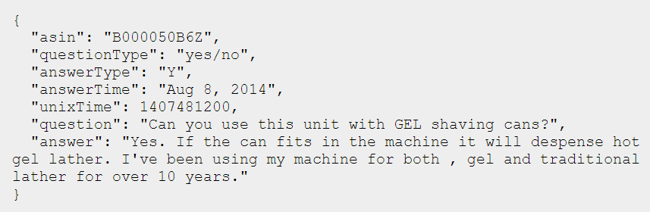
Data Selection
The dataset hails from http://jmcauley.ucsd.edu/data/amazon/qa/.com. It contains Question and Answer based on a number of subjects like food, electronics, health etc., from Amazon, totaling around 1.4 million answered questions.
Electronics – contains 314,263 questions and answers

Slide 5
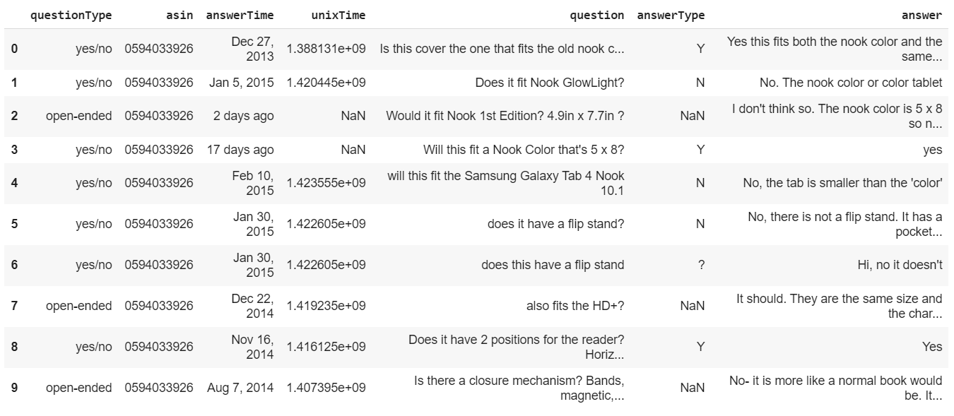
Dataset

Slide 6
Data Pre-processing
Remove null questions and also questions which have character count less than 10 - 314,263 to 312,129 entries
Drop unimportant columns from the data
Case conversion
Remove questions and answers having word length greater than 10 from the dataset
Selected approx. 11, 000 questions for training
Tokenization

Slide 7
Data Preparation
For encoder input : Tokenize the questions. Pad them to their maximum length.
For decoder input : Tokenize the answers. Pad them to their maximum length.
For decoder output : Tokenize the answers. Remove the first element from all the tokenized answers. This is the <START> element which we add earlier.

Slide 8
Defining the Encoder-Decoder model
The model will have Embedding, LSTM and Dense layers. The basic configuration is as follows.
2 Input Layers : One for `encoder input data` and another for `decoder input data`.
Embedding layer : For converting token vectors to fix sized dense vectors.
LSTM layer : Provide access to Long-Short Term cells.
Working :
The `encoder input data` comes in the Embedding layer
The output of the Embedding layer goes to the LSTM cell which produces 2 state vectors ( `h` and `c` which are `encoder states` )
These states are set in the LSTM cell of the decoder.
The decoder input data comes in through the Embedding layer.
The Embeddings goes in LSTM cell ( which had the states ) to produce sequences.

Slide 9
Model Implementation
Defining inference models
We create inference models which help in predicting answers.
Encoder inference model : Takes the question as input and outputs LSTM states ( `h` and `c` ).
Decoder inference model : Takes in 2 inputs, one is the LSTM states ( Output of encoder model ), second is the answer input sequences ( ones not having the `<start>` tag ). It will output the answers for the question which we fed to the encoder model and its state values.

Slide 10
Training
For 1000 samples, with a batch_size = 10, epochs = 50,
Training loss – 0.4015 to 0.1282
For 10,100 samples, with a batch_size = 220, epochs = 50,
Training loss – 1.5918 to 0.3710

Slide 11
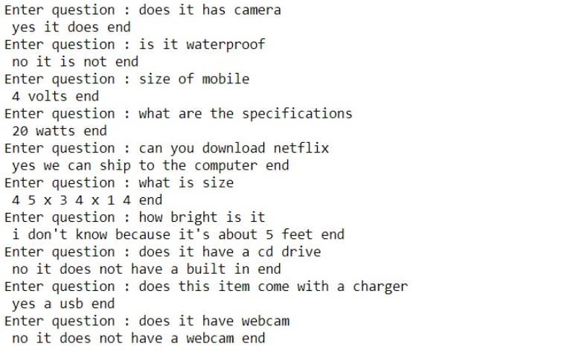
Output

Slide 12
Future Scope
Product Suggestions
Book a cab
Scheduling appointments, visits and procedures
Interacting with patients post-discharge in order to reduce admissions

